Slide 1

Text Detection in Signage
Improving ocr accuracy

Slide 2
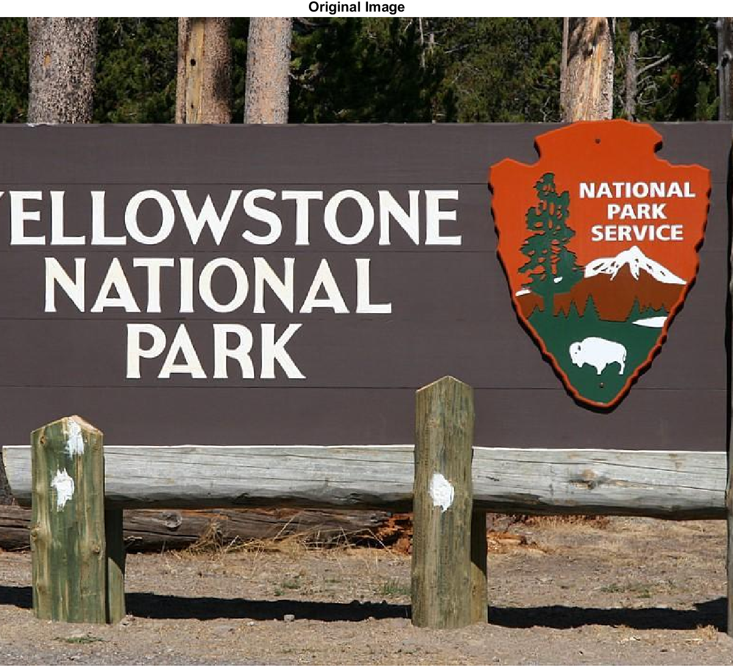
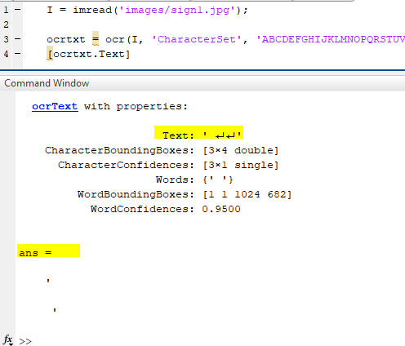
Problem

Slide 3
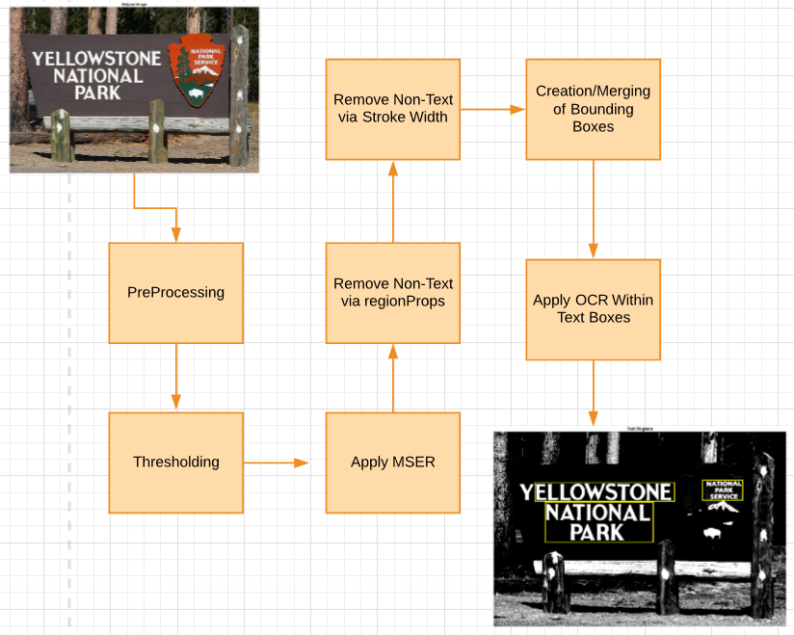
Methodology

Slide 4
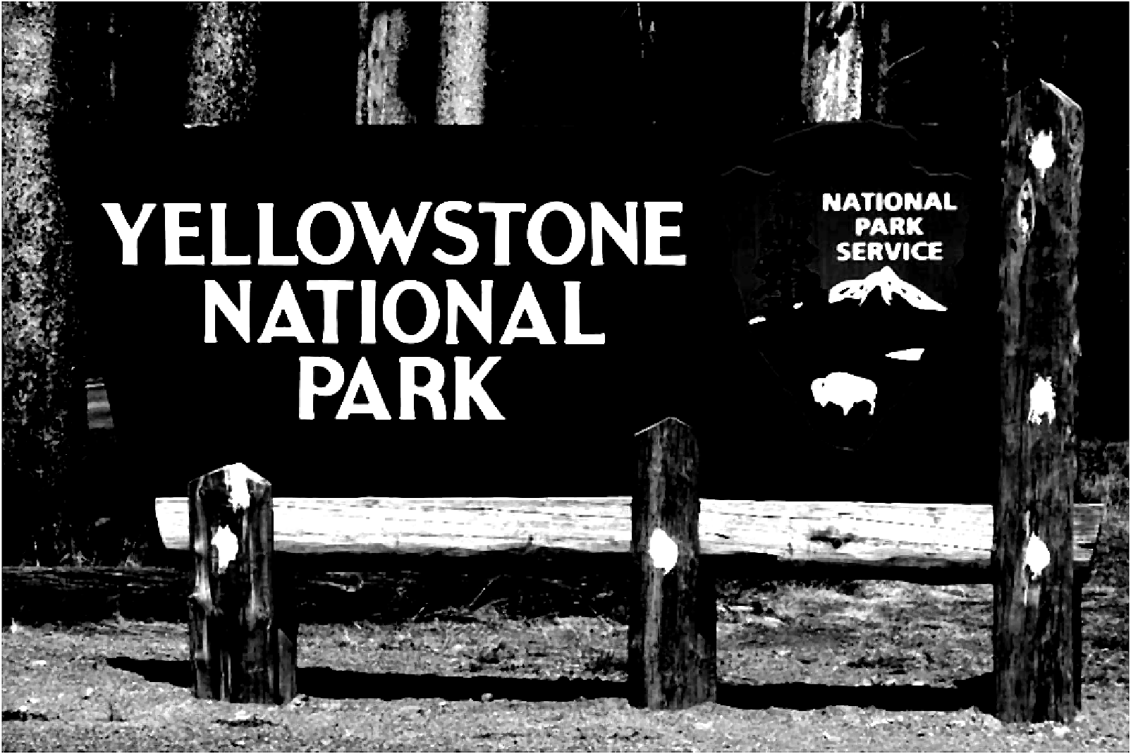
Pre-Processing
Set image to grayscale using rgb2gray.
We want to help OCR distinguish characters from the background. So I used imadjust to adjust the contrast of the image, specifying limits.
Lastly used median filter [medfilt2] pre-processing to remove as much noise as possible.

Slide 5
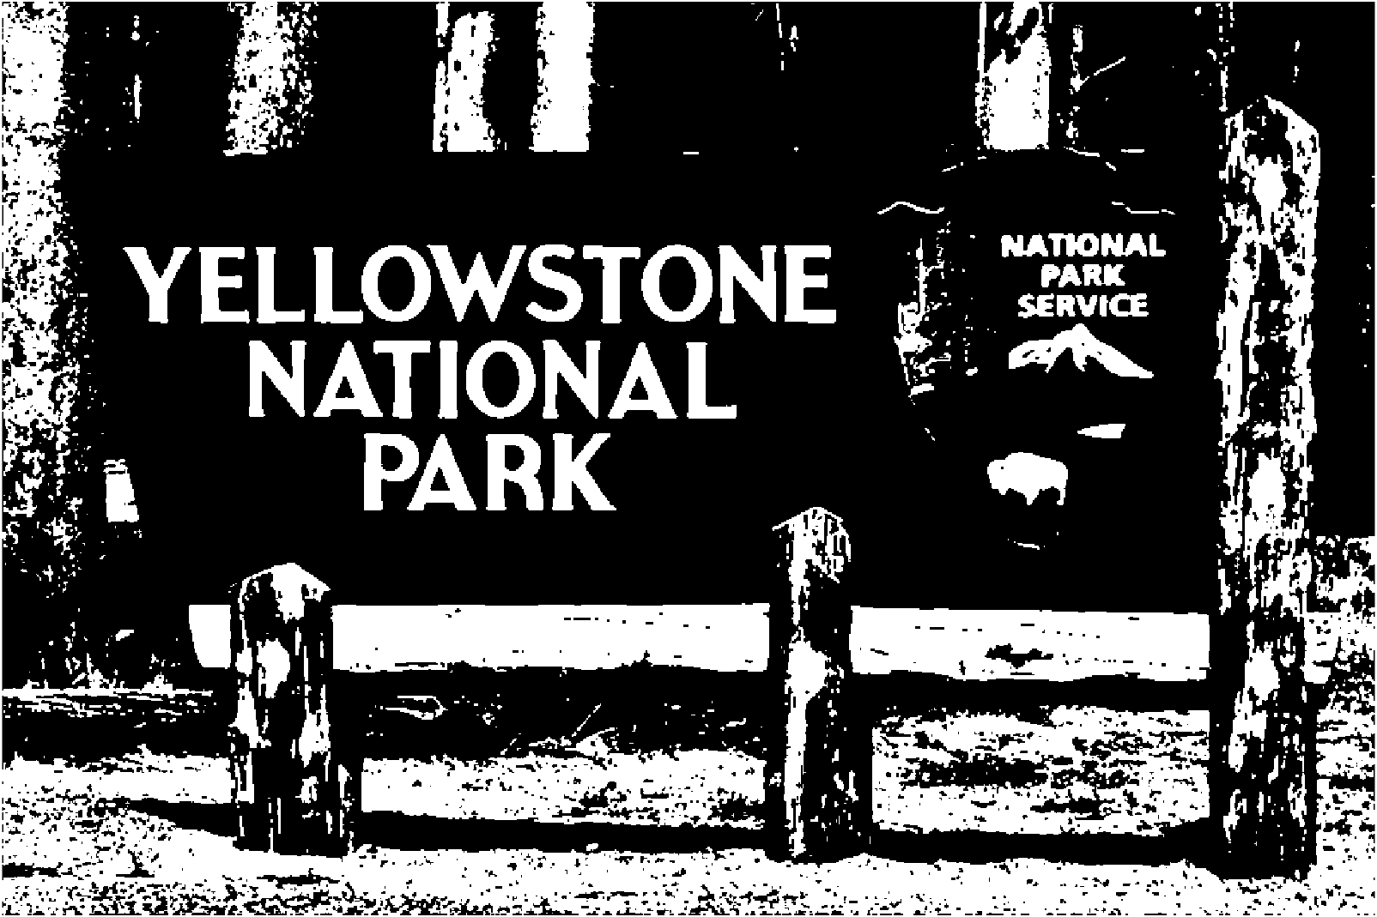
Thresholding
For this I used imbinarize() to create a binary image. Sets all values above the threshold to 1’s, and all other values to 0’s.
Very simple method, but I found it worked to define characters.

Slide 6
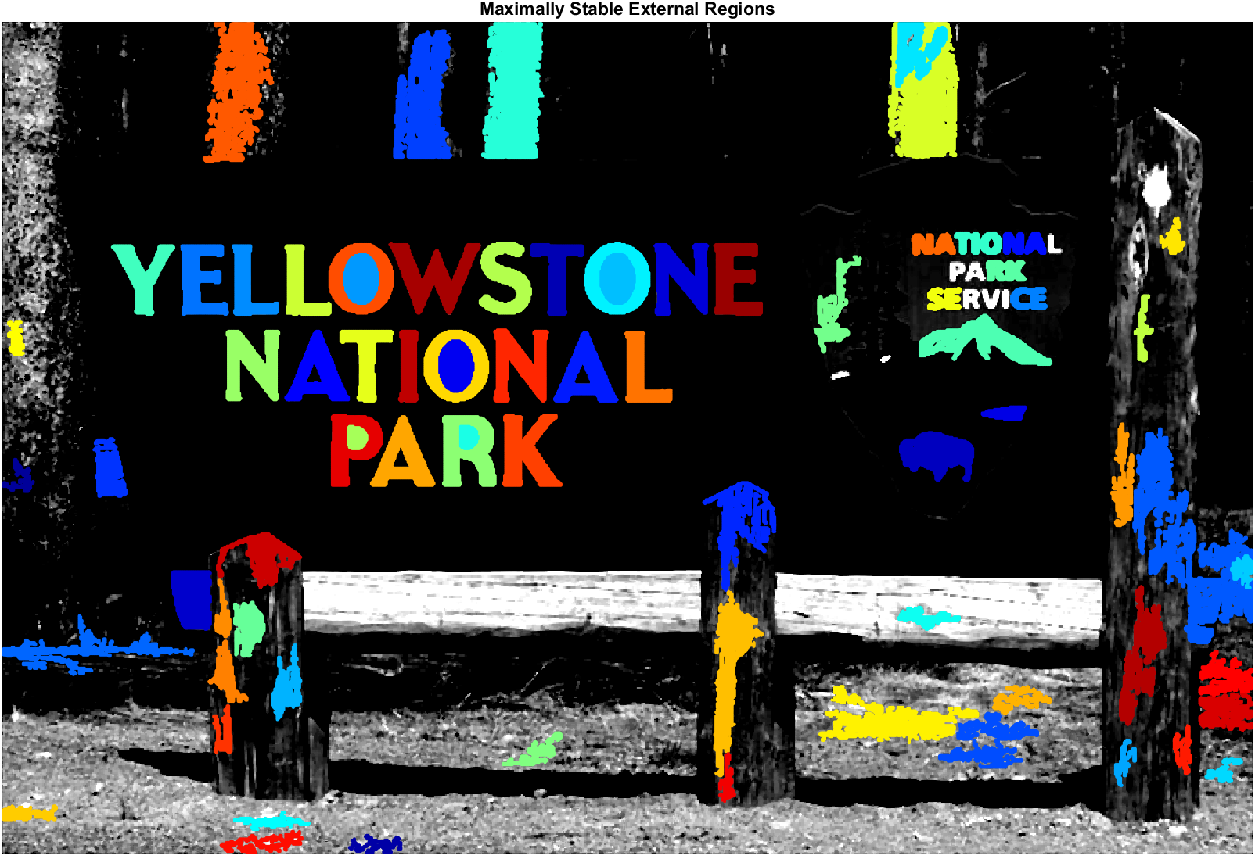
MSER
Maximally Stable Eternal Regions, or MSER, are connected areas with uniform intensity with a contrasting background.
What we are left with are the regions that remain unchanged over a large set of thresholds.

Slide 7
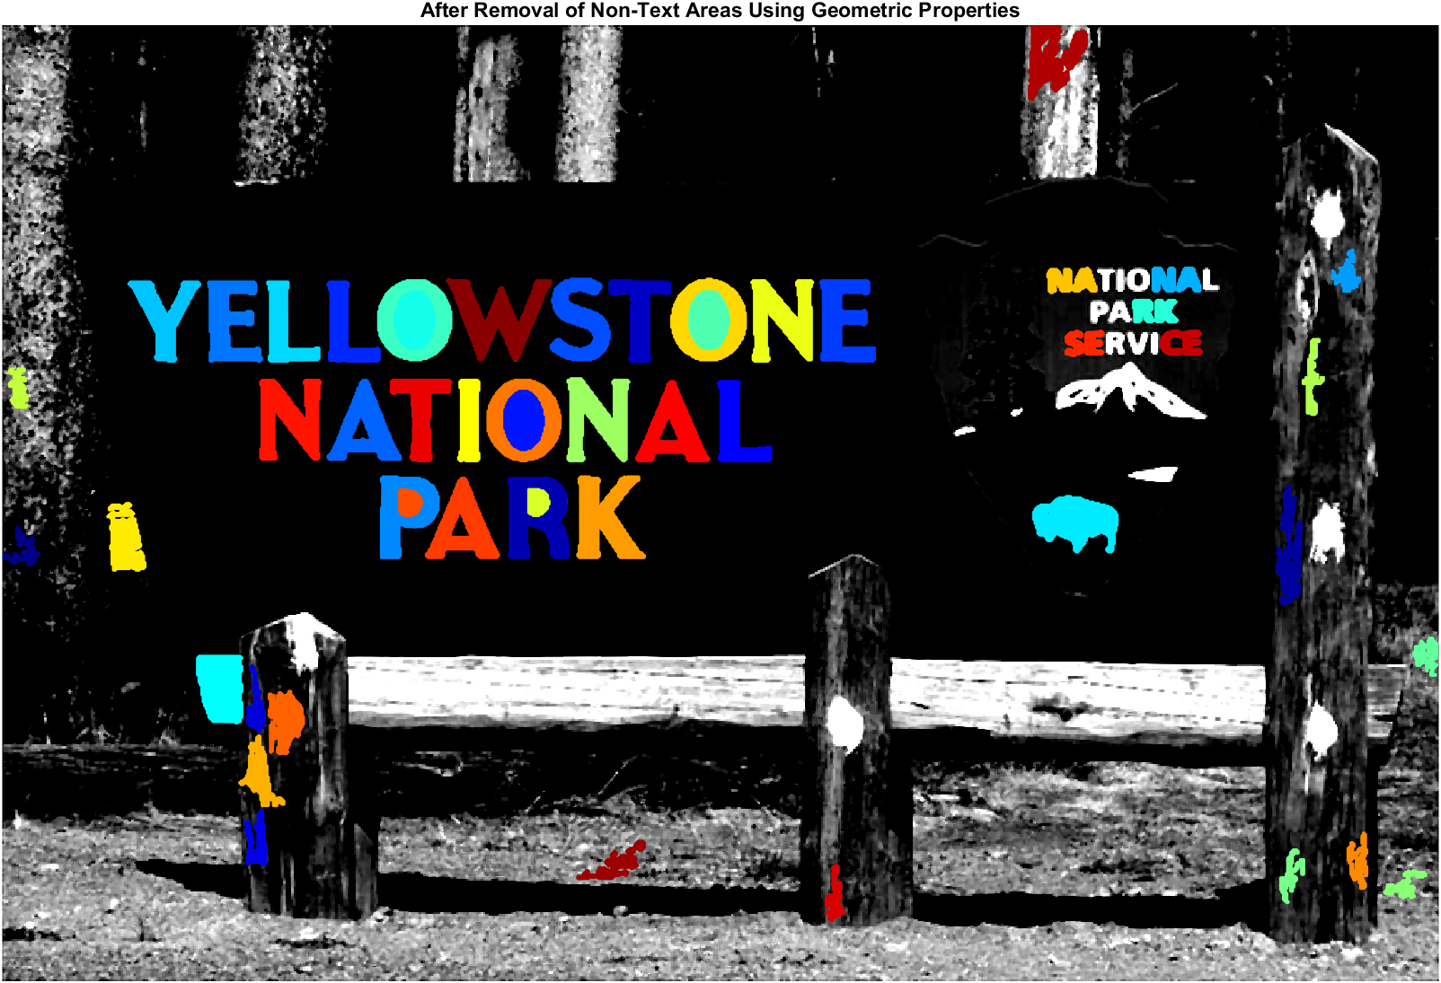
Region Props
Using regionprops, we can use shape measurements to filter out non-text regions.
The properties in use are Eccentricity[0 = Circle; 1 = Line], Solidity[Pixel Proportion], Extent[Ratio of pixels in region vs bounding box], and so on.
Then, you remove said regions, hopefully leaving you with predominantly text regions.

Slide 8
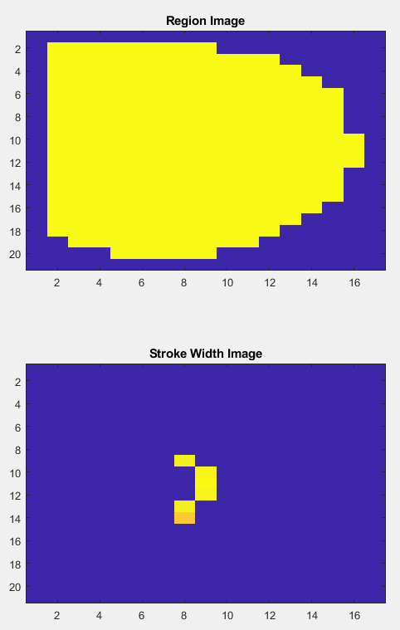
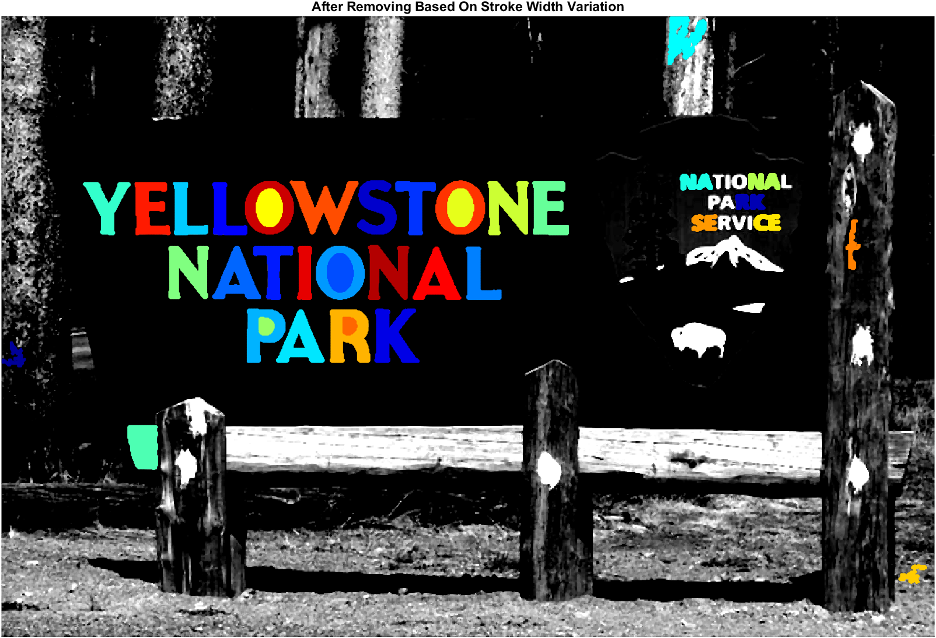
Stroke-Width Variation
Non-text regions will, on average, have large variations in stroke width compared to text regions.
Stroke width being a measure of the width of a character, in both the lines and curved areas to check for uniformity.
We can get rid of the values without said uniformity, as they are less likely to be text.

Slide 9
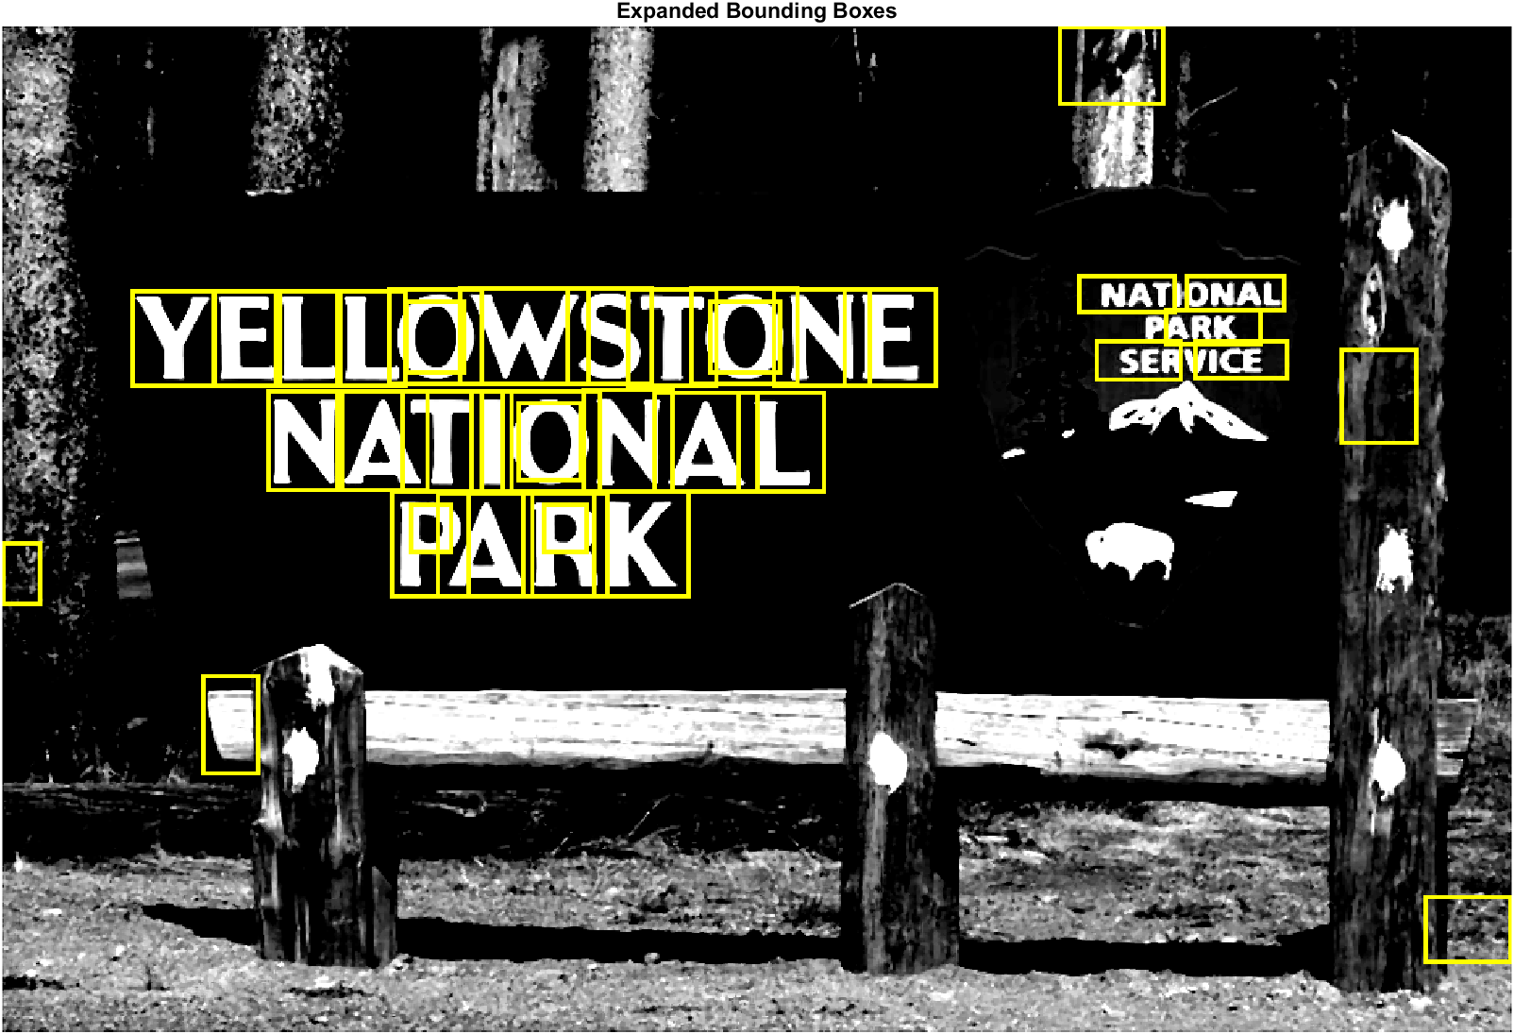
Creation of Bounding Boxes
If we can crate bounding boxes, we can then specify them as the region that OCR should read from.
These can be created using the MSER data.

Slide 10
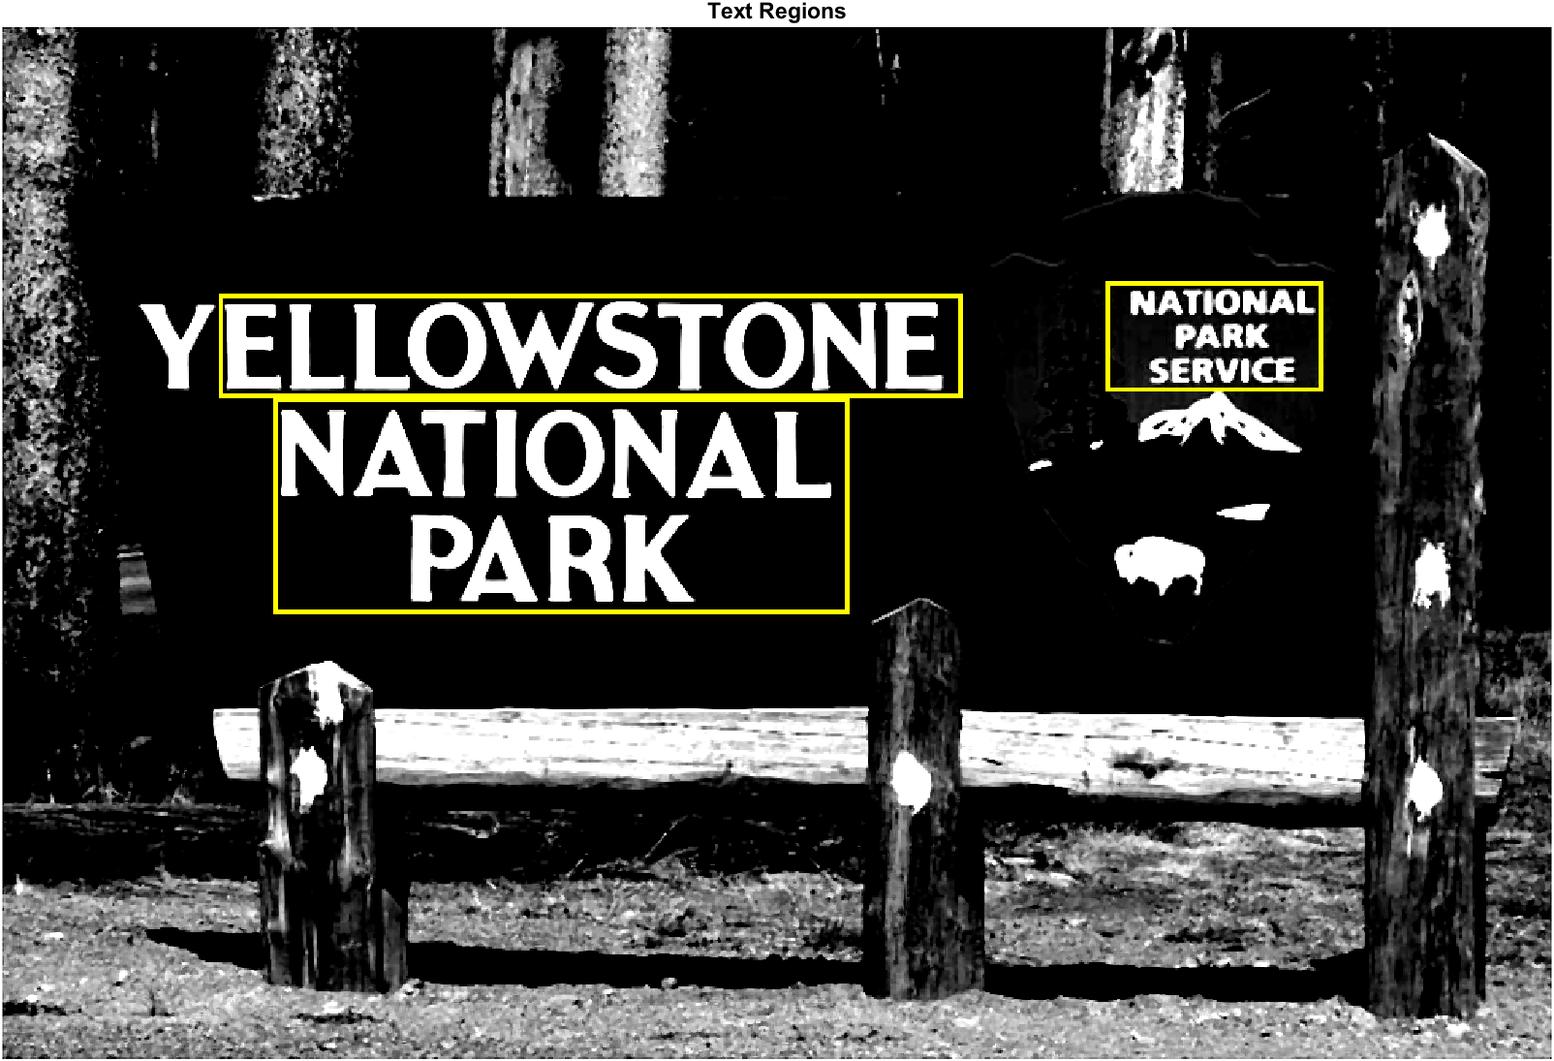
Merging of Bounding Boxes
Using bboxOverlapRatio we can combine these boxes into regions we can use for OCR.
This works well as characters that may have been missed by MSER will be included in the region.
However sometimes characters like ‘Y’ here get dropped as there is not enough overlap. Values can be tweaked but gives non-text boxes.

Slide 11
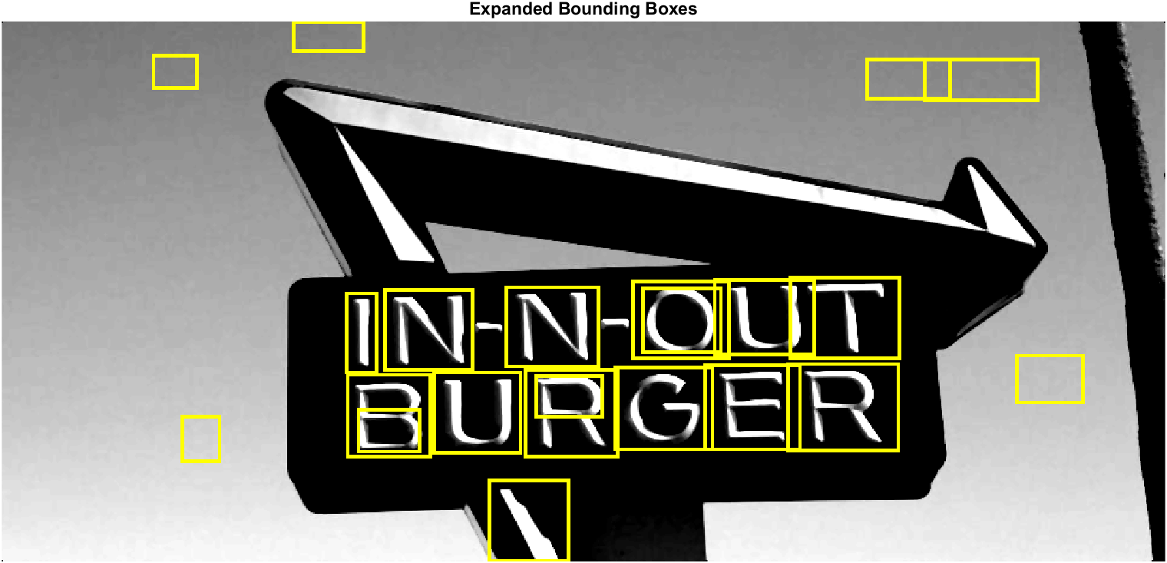
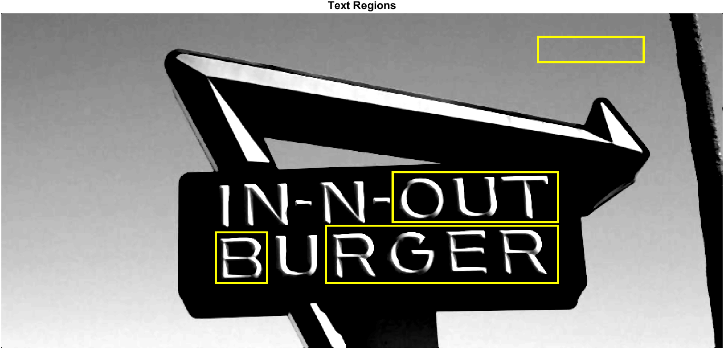
Overlap Issue:

Slide 12
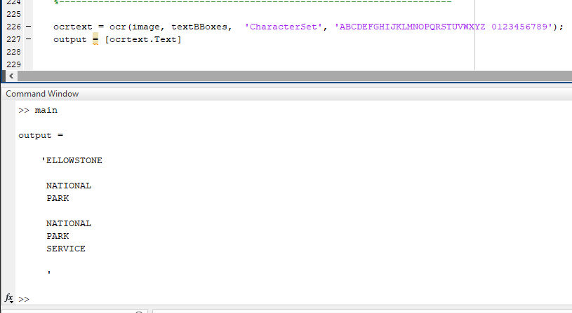
Output of OCR:

Slide 13
Improvements
There are a multitude of values that could be altered, these are just the most accurate that I could find for my set of images.
Currently, it is not a ‘one size fits all’ method.
Could utilize image classification methods such as Convolutional Neural Networks.

